Slide 1

Topic: Free Memory Management
Lecture: Dr. Zhao Jie
Date: 03/25/2026

Slide 2
Reading Assignment
Chapters 17

Slide 3
Agenda
Variable size allocation
Internal fragmentation and external fragmentation
Variable size allocation strategies (first fit, best fit, and worst fit)

Slide 4
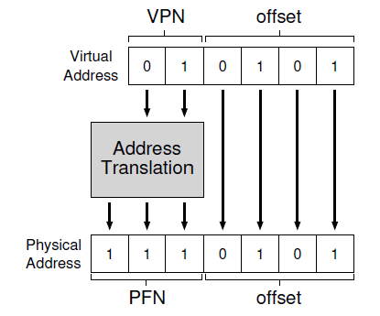
The motivation of the varied-size piece - 1
The advantage of using the fixed-size piece
- Each page has the same size, like 1KB or 4KB
Easy to compute the memory address. In the example, if the PFN is known, the memory address can be calculated.
Notes:
Q1: Where is swap space?
C1: In hard disk, basic storage unit is block.

Slide 5

The motivation of the varied-size piece - 2
The disadvantage of using the fixed-size piece
- If each page has the same size, it will cause internal fragmentation and external fragmentation.
The internal fragmentation means that the allocated memory piece is larger than the user request, so that the surplus becomes the waste.
The external fragmentation means that the user cannot get the requested memory, even though the total size of the free memory pieces is enough, but these pieces are not consecutive.
Notes:
Q1: Where is swap space?
C1: In hard disk, basic storage unit is block.

Slide 6

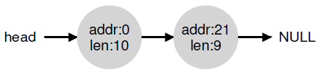


Low-level mechanism
The free list of memory (unit assumed: KB)
- Initial state:
Request 1KB:
After returning 10KB:
Coalescing to get a big whole chunk of free memory:
Notes:
Q1: Where is swap space?
C1: In hard disk, basic storage unit is block.

Slide 7
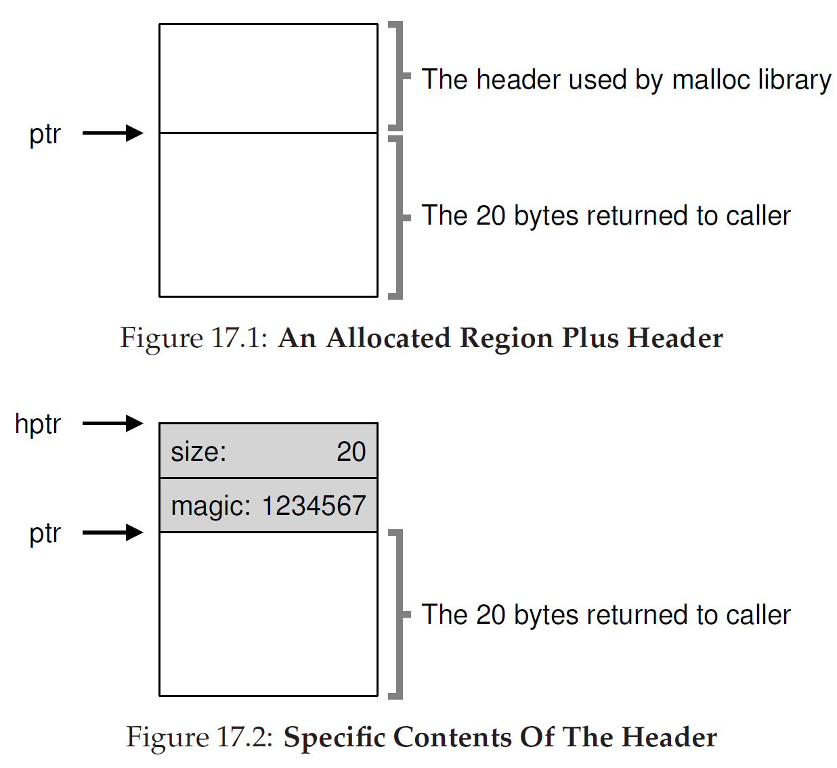
Free memory with meta data
Free memory chunk
Header + Free size
Header size: 8B
An allocated memory chunk
Flag: 1234567 indicates that the memory is a flag, as allocated and occupied.
Notes:
s

Slide 8
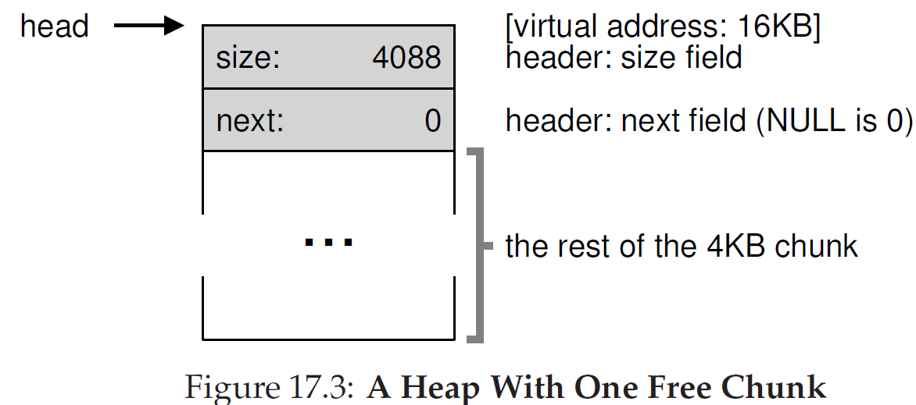
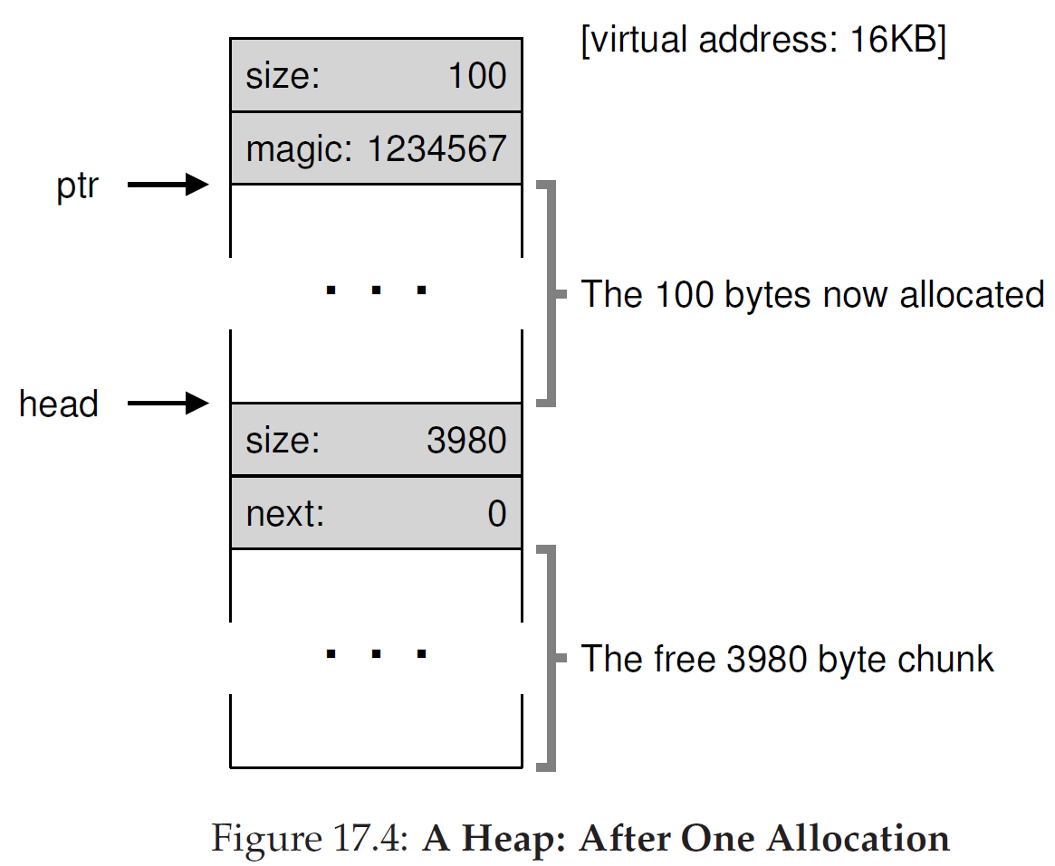
Free memory list with meta data - 1
A free memory chunk
Header(8B) + Free size (4088 B) = 4KB
An allocated memory chunk and a free chunk
Allocated: 100B+8B
The rest free: 3980B + 8B
Notes:
Page Table: VPN -> Block No. in disk, not PFN

Slide 9
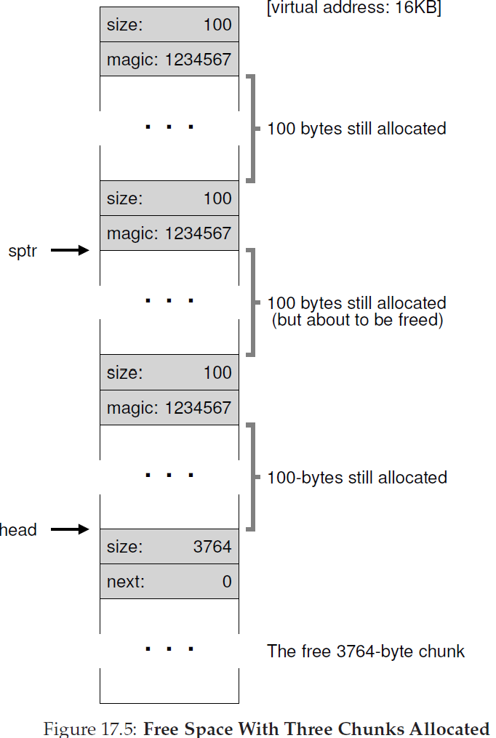
Free memory list with meta data - 2
Three allocated memory chunks and a free chunk
Allocated: three blocks (100B+8B), but consecutive.
Free: 3764B + 8B
Practice: Can you draw a free memory list using single link direction(from head to tail)?

Slide 10
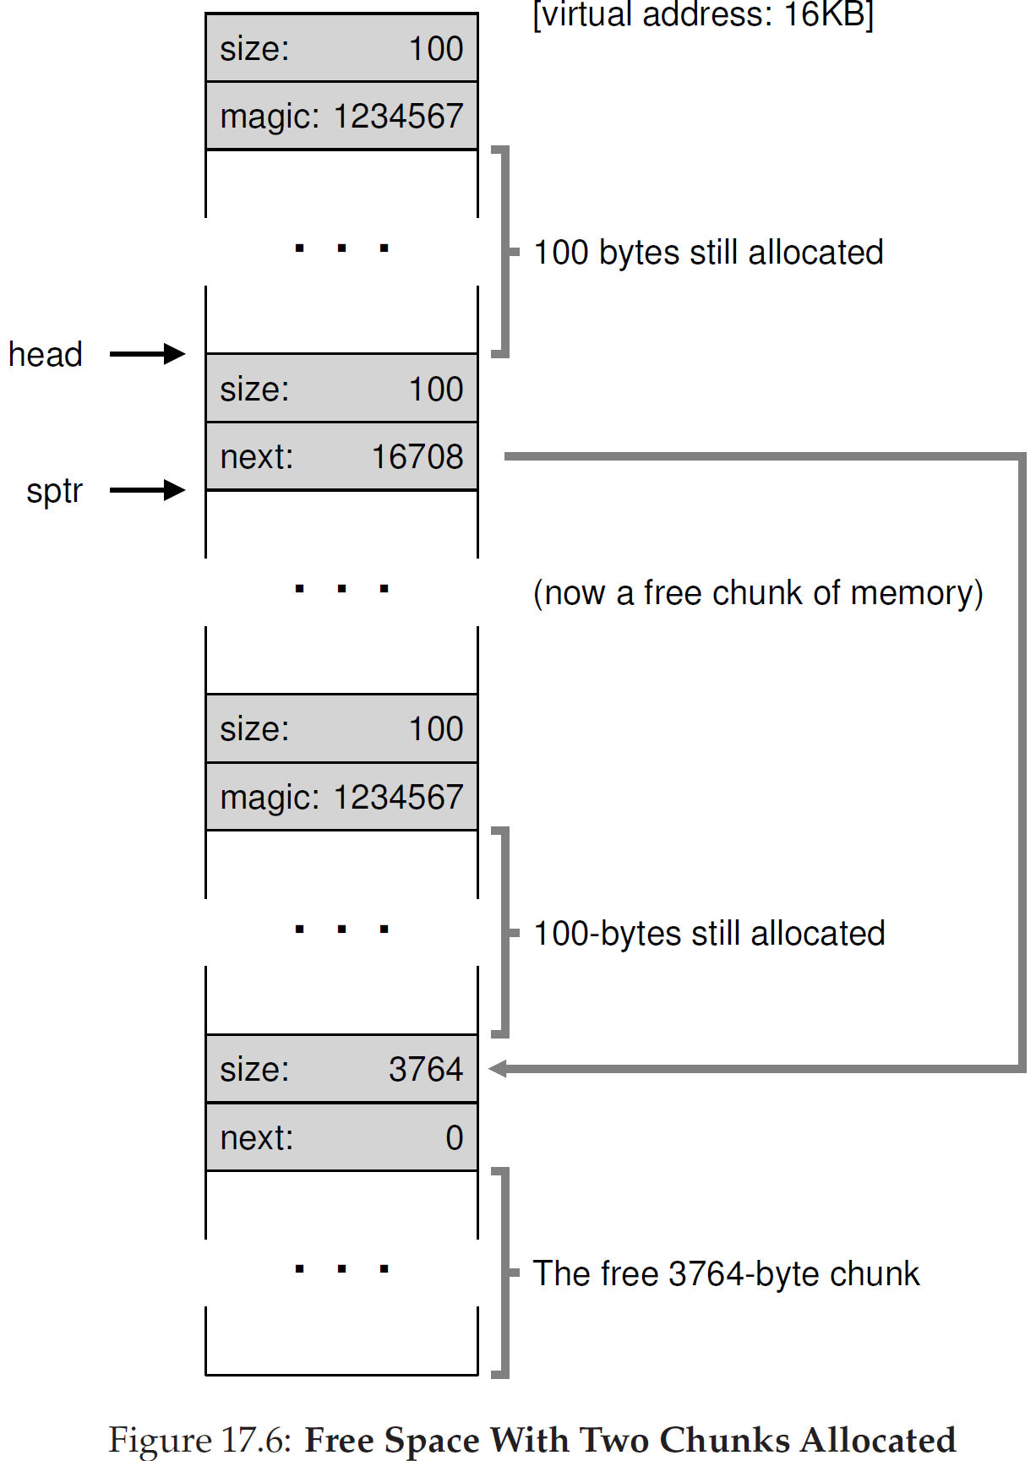
Free memory list with meta data - 3
Two allocated memory chunks and two free chunks
Allocated: two 100B+8B
Coalescing the middle free memory chunk to the rest of the free chunk. The way to coalesce is to make the new free chunk point to the rest of the free chunks.
So, knowing the entry address of the rest of the free chunk is critical:
Next: 16 KB (14-bit addr space) + 324 B (allocated)
Practice: Can you draw a free memory list using single link direction(from head to tail)?

Slide 11
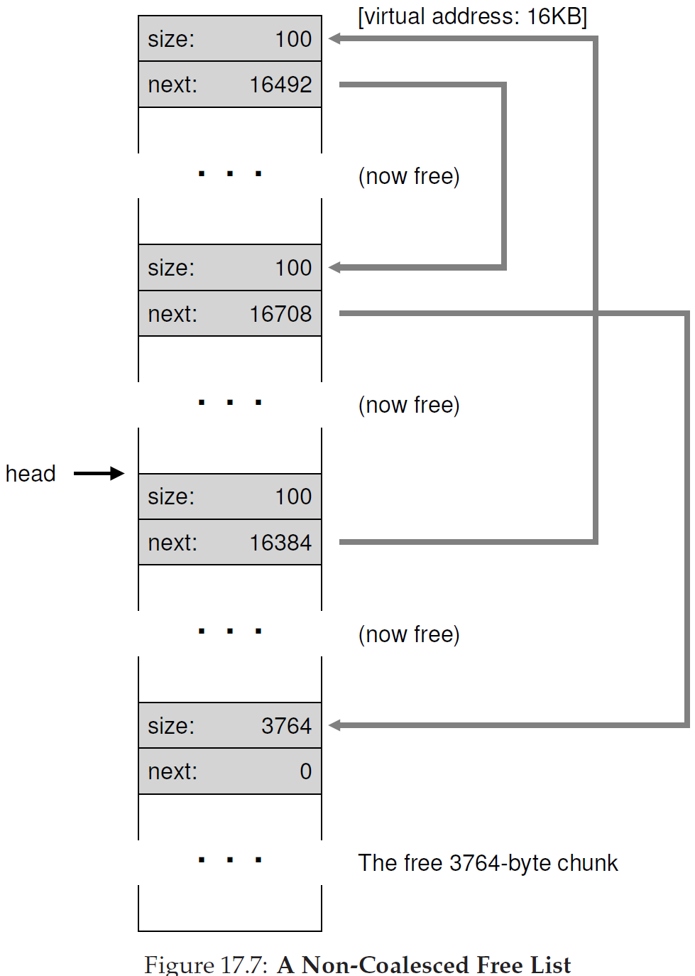
Free memory list with meta data - 4
Practice:
Explain how to get the next address in each block?
Can you draw a free memory list using single link direction(from head to tail)?

Slide 12
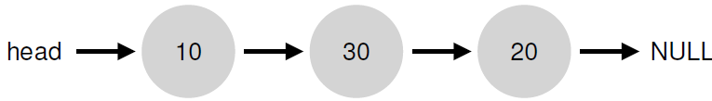
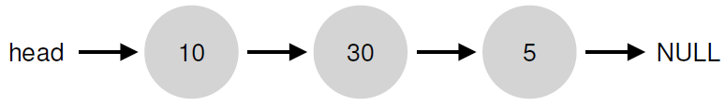
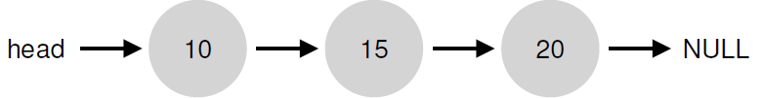
Variable size allocation strategies
First fit: allocate first free chunk that is sufficient
Best fit: allocate free chunk that is closest in size
Worst fit: allocate free chunk that is farthest in size
Example, consider this free list, and malloc (15)
Best fit would allocate the 20-byte chunk.
Worst fit would allocate 30-byte chunk: remaining chunk is bigger and more usable

Slide 13
Fixed size allocations
Memory allocation algorithms are much simpler with fixed size allocations
Page-sized fixed allocations in kernel:
--- Has free list of pages
--- Pointer to next page stored in the free page itself
For some smaller allocations (e.g., PCB), kernel uses a slab allocator
--- Object caches for each type (size) of objects
--- Within each cache, only fixed size allocation
--- Each cache is made up of one or more “slabs”
Fixed size memory allocators can be used in user programs also (instead of generic malloc)

